Slide 1
Books Generated By AI Chatbot
By: Asum Zahid

Slide 2
Step 1 – Description
My project is going to use an AI chat bot to categorize an assortment of books on information that is found online telling the user where this information comes from and what it categorizes in. As well as utilizing the AI chat bot to type in a random specific topic of study such as the Software Development Life Cycle and having a list of books regarding the SDLC process appear on the screen. Furthermore, the user can type in any text and or paste an image and the chatbot should be able to recognize where this information comes from.
The meaning of G P T is that it is a generative pre-trained transformer and is part of the family of neural networks models that use transformer architecture. It powers AI applications such as ChatGPT.
Neural Networks are machine learning models that teach computers to process data such as a human would. It’s a deep learning type of machine learning. It is a series of algorithms that recognize relationships in data. Made up of millions of nodes and are used to solve problems like image and voice recognition.
Some of the latest algorithms that I may be planning on using in my own project include Seq2Seq model (Sequence-to-sequence0 allowing for text summarization, image captioning and translation. Another algorithm that can be helpful in accordance with my AI chatbot is the Naïve Bayes algorithm which allows for text classification. Other algorithms that I will be using are the decision tree, natural language processing, support vector machine, recurrent neural network, long short-term memory, document parsing, genetic and damm algorithm.
Case Tools (computer-aided software engineering tools) that I can possibly use for my project are some types of analysis /data dictionary tool to reduce data redundancies such as IBM InfoSphere Information Governance Catalog and AWS Glue Data Catalog. Furthermore, some other case tools that can be utilized are Amazon machine image, OMT(object modelling technique), Accept 360 and Dependency Finder.
Some of the latest existing MCOTS programs I will be using for my project include Microsoft Bot Framework which will help me build, test, and deploy my chatbot. Rasa is another tool used to build custom AI chatbots with custom actions. Other MCOTS programs I can utilize include SAS(Statistical Analysis Systems), Microsoft SQL Servers, Oracle Databases, Xero, Kustomer and Improvado.

Slide 3
Step 2 – Functions
1. User Input – The user inputs what book or type of information they are looking for.
2. Error Detection – That information or type of book topic does not belong or exist in our database directory.
3. Availability of Books – Check if the books are available to purchase online through e-text.
4. Multilanguage Support – Supporting different languages of books and information found in our database.
5. Multi Model Search – Having the ability to input images and texts to search for books/information relevant to that image/text.
6. Filter Results – Having the ability to filter your results by release date, author, and edition of book.
7. Scanning Databases - Using public libraries or sites to scan for specified information/books.
8. Information Retrieval – Gathering information on a specific topic from an online database such as google scholar, science.gov or other public open-source platforms.
9. Content Categorization – Finding out what information that was searched for categorizes into which specific book.
10. Generated List of Books – After scanning the databases a generated list of books will appear that are relevant to the specified topic.
11. Origin of Information – The origin of information allows for the author of the book, what year the book was released and other specific information to be printed on the screen.
12. Content Summarization - After generating a list of books relevant to the topic a short summary can be given of what the book entails.
13. Review and Ratings – A list of reviews and ratings will be generated with the books listed.
14. User History – Being able to save and clear your search history if wanted.
15. Bookmarked – Having the ability to save any specified book listed for future reference.
16. Content Preview – Allowing for some sort of preview of the subject books, an example would be a chapter sampled from the specified textbook.
17. Book Recommendations – Asking for similar books on the topic will lead to book recommendations from the chatbot.
18. Feedback Response – After the user inputs what information or type of book, he is looking for the next response could be a more detailed search or other options such as saving a specific book.

Slide 4
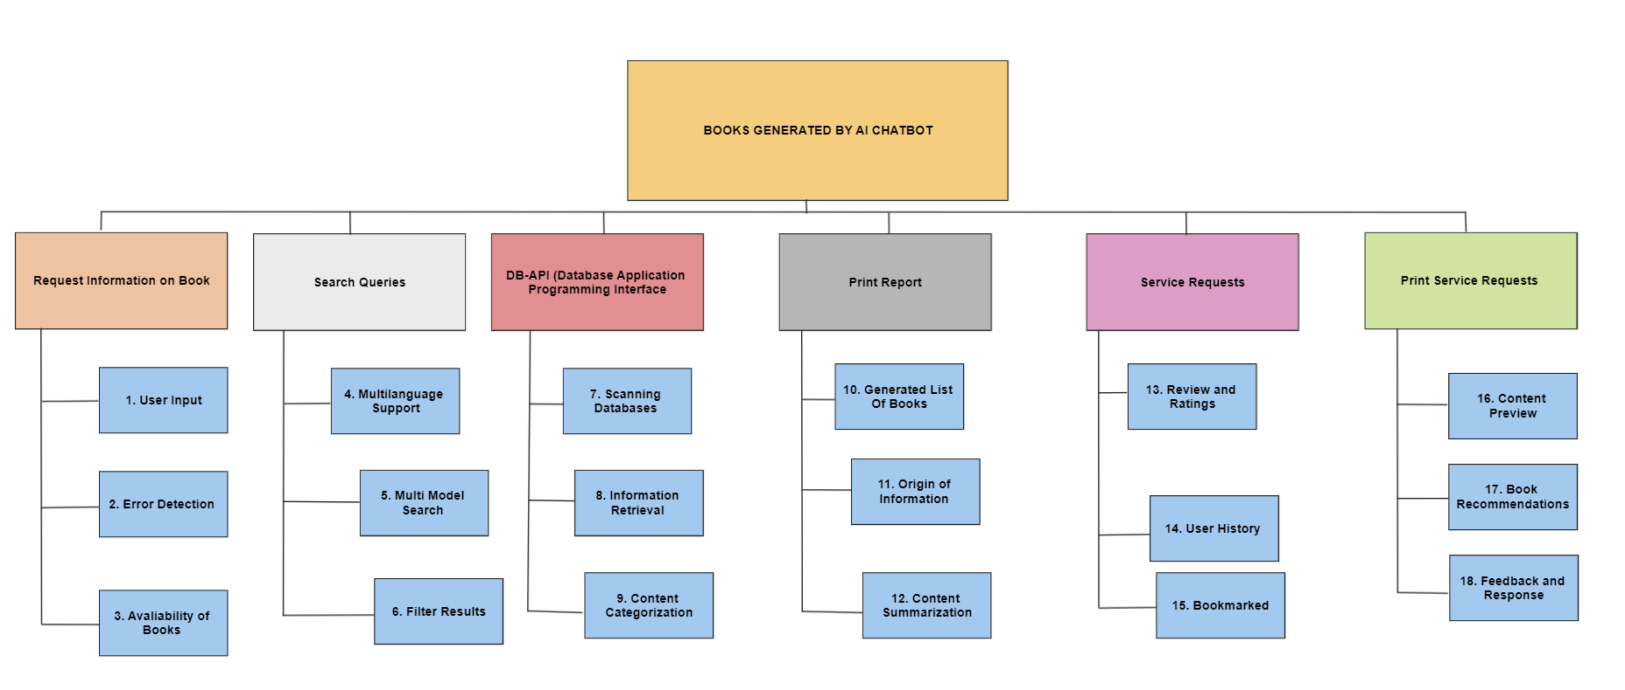
Step 3 – Block diagram

Slide 5
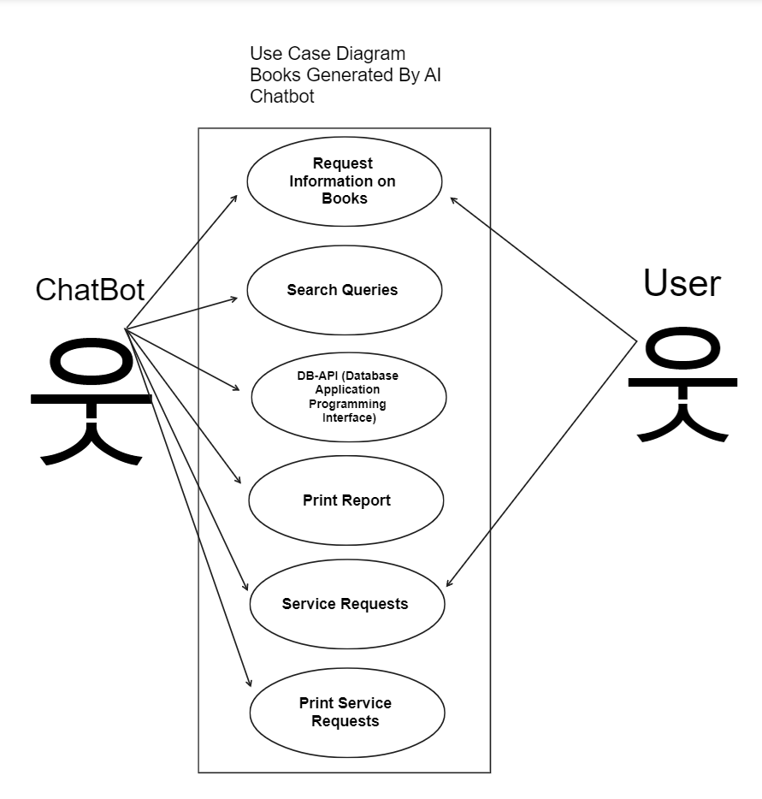
Step 4 – Use Case

Slide 6
Step 5 – Pseudocode
Specific Function - The user asks for the availability of a book, scan the database and check the availability of the books.
void perform_scan ()
{
String storedinformation;
int avaliability_ofbooks;
if(get_input(perform_scan) is null)
print "error 1: information does not exist";
else
produce_output(avaliability_ofbooks;
}
}

Slide 7
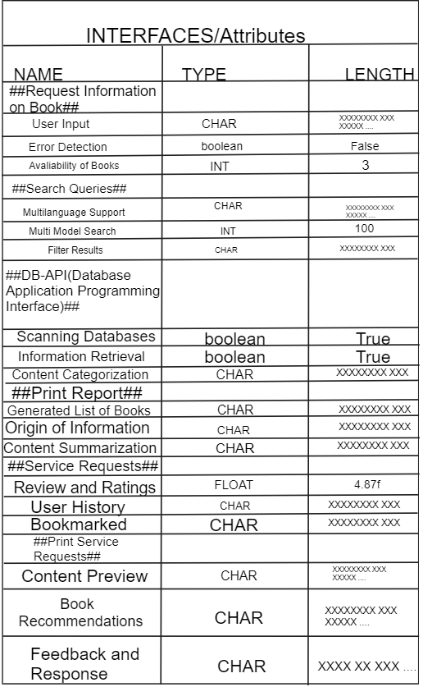
Step 6 – Interfaces

Slide 8
Step 7 – Non-Functional Requirements
Size – System Initially sized for 1000 requests, scalable to 2000 requests with no major modifications.
Response Time – Update response in less then 1 second.
Reliability – System may slow down/go down/crash once a month for 10 minutes.
Security – Software Access to data secured by
1- Password
2- Email Security
3- SMS Verification

Slide 9
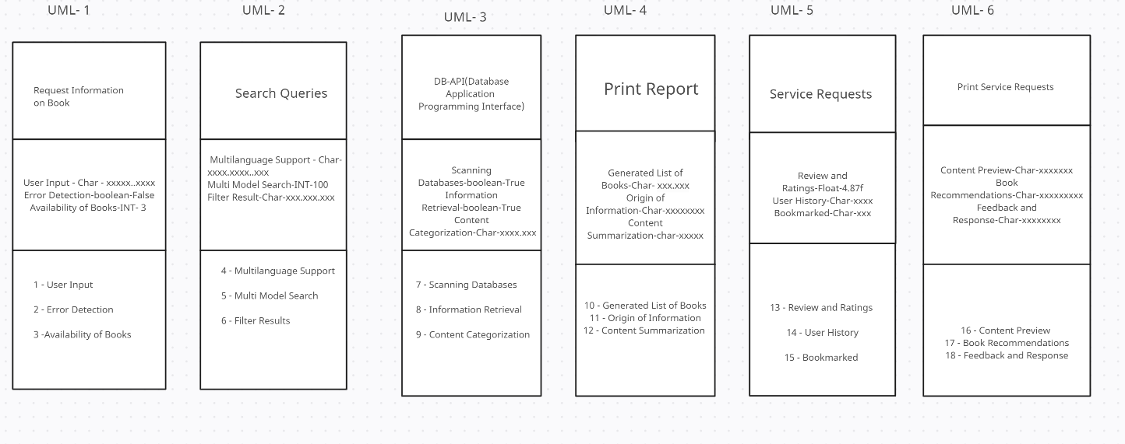
Step 8 – UML Diagram

Slide 10
Step 9 – CMM (Capability Maturity Model)
The 5 different levels of CMM(Capability Maturity Model) are the initial level which is described as ad hoc process, and occasionally chaotic in this level few of the process’s are defined and success is dependent upon the individual entirely. Level 2 is the repeatable level where basic managements are established. Level 3 is the defined level where both management and engineering activities are utilized and integrated. The projects use data collected in all defined processes and are systemically shared. Level 4 is the managed level where software process measurement occurs. Both software and product are understood. Finally, level 5 the optimizing level is where the process is controlled allowing for a continuous process of improvement. My project is most closely represented by level 3 because data is collected and shared across all projects and used in all defined processes. Furthermore, the management and engineering processes are all documented and integrated for developing our software.

Slide 11
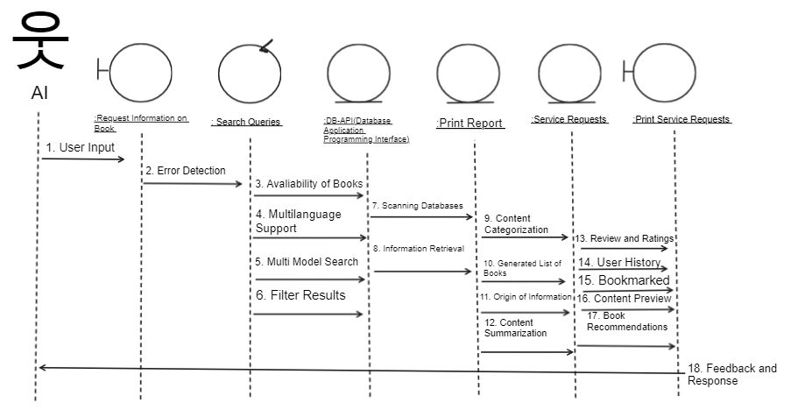
Step 10 – Sequence Diagram

Slide 12
Step 11 – Case Tools
1. IBM InfoSphere Information Governance Catalog – An interactive web-based tool that allows users to create, manage and share documents and allows the user to track data.
2. AWS Glue Data Catalog – A repository for data assets across various data sources providing the use to store and query information.
3. Amazon Machine Image – Create virtual servers in the AWS environment containing virtual operating systems and applications. Different instances of AMI can be launched to support the hardware of the computer.
4. O.M.T (Object Modelling Technique) – OMT helps analyze and implement software aimed to create models of object-oriented software. It helps design solutions by creating object models it helps with easy maintenance and faster development of software, while supporting object -oriented programming.
5. Accept 360 – Focuses on collecting specific requirements and analyzing them while atomically checking for any irregular unwanted information.
6. Dependency Finder – A tool that allows an analysis of graphs for useful information.

Slide 13
Step 12 – Implementation
Project - Books Generated By AI Chatbot – Google Cloud Machine Learning Engine is a service that will help build and train machine learning models.
1.Request Information on Book - SAS (Statistical Analysis System) – Gives us the ability to perform statistical analysis and read data from HTML, RTF and PDF docs.
2.Search Queries – Microsoft SQL Server a relational database management system that will help get information remotely.
3.DB-API(Database Application Programming Interface) – Oracle Database a collection of data organized by type can help store and retrieve data.
4.Print Report – Xero is a reporting software tool that helps projects manages inventory and prints reports of financial reports.
5.Service Requests – Kustomer is a help desk software that can help us take request and reply and has a configurable interface to automate tasks.
6.Print Service Requests – Improvado a data tool that automates reporting it can connect to multiple data sources and turns data into automated reporting.
1.User Input – Standford CoreNLP is a set of natural language analysis that can take language text input.
2.Error Detection – Jira is a software that we can use to track bugs and errors for our project.
3.Availability of Books - inFlow Inventory is a management software that will help us track and report the availability of books of a product.
4.Multilanguage Support – Natural Language Toolkit contains text processing libraries that can help recognize human language data.
5.Multi Model Search - ArcGIS allows view of geographic information using imagery tools for visualization and has access to the world's largest imagery collection.
6.Filter Results - IBM SPSS is a software package that can help us analyze statistical data it can help filter out unwanted data by accepting raw data and converting it into relevant statistics.
7.Scanning Databases - IBM DB2 is a data management product that manages data from multiple databases allowing access to multiple warehouses of data.
8.Information Retrieval – Amazon Relational Database Service a web service that will help access and export a variety of databases and do tasks such as data migration.
9.Content Categorization – Microsoft Access can help manage large sets of information and analyze it managing it more efficiently while minimizing duplicates and errors.
10.Generate List of Books – Athennian a cloud-based software that will centralizes data and has a reporting feature as well as document assembly.
11.Origin of Information – MongoDB is a documented oriented database that stores high volumes of data storage.
12.Content Summarization - Microsoft Power BI will help turn data with different data sets into coherent charts or graphs.
13.Review and Ratings – Yogi is an AI powered customer feedback that reviews products and gives you feedback on user reviews.
14.User History – Google Cloud Storage is a RESTful online web cloud service that stores data and history from its users.
15.Bookmarked – Panoply is a data management software that can store, organize and analyze data from different sources and has built-in data integration.
16.Content Preview – Apache CouchDB a document database uses multiple formats to store, transfer and process data.
17.Book Recommendations – TensorFlow an open-source software library used for machine learning can manipulate and analyze data providing the option to the opportunity to interact libraries with machine learning models.
18.Feedback and Responses – HPE Ezmeral Unified Analytics Software allows analytical AI generated responses.

Slide 14
Step 13 – Project Management Plan
Overview
1.1 – Project Summary : Use an AI chat bot to categorize an assortment of books on information that is found online telling the user where this information comes from and what it categorizes in.
1.1.1 – Purpose, scope and objectives : The purpose of this software product is to allow users to search for topics of books through the utilization of an ai chatbot scanning different databases and retrieving information while also completing certain specified tasks.
1.1.2 – Assumptions and constraints : The software should produce a response within 3 seconds of user input unless the topic of information is not listed or found in our databases.
1.1.3 – Project Deliverables : The AI generated response should be printed to the user including all extra service requests.
1.1.4 – Schedule and budget summary : The AI chatbot will be running almost all the time except for maintenance work and the budget will be adjusted to future updates and changes.
1.2 – To ensure any unexpected errors or bugs the project management plan is subject to change if needed such as if certain features need to be added the developer team will need to adjust/change the software to the clients need.
2. Reference materials : The documentation used in the project are listed here such as any Api libraries, databases used, or frameworks included.
3. Definitions and acronyms: The information used will be the same for everyone involved in this project with instructions being listed in English and a basic understanding of the software development process to be already expected by everyone involved in the project.
4. Project Organizations :
4.1 – External interfaces : The individuals working on this project are not limited to just the individuals in the company's dev team as other outside developers may be able to add onto our software product.
4.2 – Internal Structure : The boundary between administrative and managerial access should be clear, the developmental groups should coexist with other supporting groups to contribute to conjunction with one and other.
4.3 – Roles and responsibilities : Each role and responsibility of an individual working in the project should be clearly stated and each role must take ownership of the contribution they are making ensuring quality assurance for each activity done.
5. Managerial process plan –
5.1 – Start-up plan : The start-up plan includes assigning roles and responsibilities to one and other and detailing how the project will start.
5.1.1 – Estimate plan : This stage is used to estimate how long the project will take and how much the costs will be it is imperative a project has certain deadlines and the cost be recognized early on.
5.1.2 – Staffing plan : The number of employees or personnel needed for this project and how long we will be contracting them or how long they will be assigned to this project.
5.1.3 – Resources acquisition plan : This stage identifies how the project tools such as hardware and resources will be acquired either that be by buying the necessary tools or already having them at the work site.
5.1.4 – Project staff training plan : The training for the staff involved in the project are listed here for example if a staff needs to be trained before entering or contributing to the project, they must be trained accordingly to learn the necessary skills required.
5.2 – Work plan : The work plan includes how work activities will be done with accordance to the scheduling and budgeting of those activities.
5.2.1 – Work activities : The specified work activities such as working on x, y and z of the project are listed here.

Slide 15
Step 13 – Project Management Plan Cont.
5.2.2 – Schedule allocation : The schedule planning or the time allocation should be that x, y and z are finished within this timeframe.
5.2.3 – Resource allocation : Ensuring that the proper resources are given to each employee or contractor involved in this project.
5.2.4 – Budget allocation : Ensuring that the budget for this project is divided accordingly and is broken down to each phase of development.
5.3 – Control plan : The control plan is how the project will be controlled with clear directions, guidelines and deadlines established.
5.3.1 – Requirements control plan : The requirements are subject to change in any software product to ensure a smooth change in plans after every development phase a review for the software should be done to see if any changes are needed now instead of in the future.
5.3.2 – Schedule control plan : This is where one needs to check if the deadlines are being met with each finished part of the project to be checked for the planned progress and if the developer is behind on the progress the entire developer team needs to pitch in.
5.3.3 – Budget control plan : Monitoring how much money is spent to ensure the budget is not exceeded its original cost is crucial to the projects success and if it looks like it may go over exceeded cost a meeting with managerial members occurs.
5.3.4 – Quality control plan : The way in which quality is measured is from developers not being able to move from the next phase of the software until all requirements are met and checked over by a supervisor.
5.3.5 – Reporting plan : A reporting mechanism or plan needs to be in place to ensure budget and schedule are not being left behind.
5.3.6 – Metrics collection plan : Metrics such as cycle time, quality of delivered product and user satisfaction should be met.
5.4 - Risk management plan : To limit risks they must be addressed immediately if spotted by a developer.
5.5 – Project close-out plan : Once the project is completed all employees or contractors are reassigned or have completed their contracts.
6. Technical process plan -
6.1 – Process model : A detailed description of the life cycle our team is using on this project like the software development life cycle.
6.2 – Methods, tools, and techniques : The methodologies such as the agile method and the tools and techniques like the programming language we are using in this case being java and other necessary techniques are listed here.
6.3 – Infrastructure plan : The specified case tools that are used in the project as well the operating system we are using to develop our product are listed such as windows and Amazon image processing.
6.4 – Product acceptance plan : Product acceptance ensures the product passes all necessary tests such as the acceptance testing, and all the criteria are met along the way.
7. Supporting process plan –
7.1 – Configuration management plan : Configuration of all aspects of the product are managed.
7.2 – Testing plan : Testing all aspects of the product are planned such as planning to do unit testing on each component if necessary.
7.3 – Documentation plan : A list of documentation that has been used in the development of the project needs to be decided and done towards the end of the project.
7.4 – Quality assurance plan : Planning and conducting quality assurance tests on the product to review its standards before given to the client.
7.5 – Reviews and audits plan : How revies and audits are conducted are planned.
7.6 – Problem resolution plan : Planning how problems or unexpected errors that have occurred should be solved or have been solved.
7.7 – Subcontractor management plan : Managing subcontractors work and how we approach working with them and involving them into our project are planned/managed.
7.8 – Process improvement plan : Planning any improvement plans to make the product better such as adding new features taking out features that may not be wanted.
8. Additional plan - Additional plans such as security or safety plans regarding data safety are discussed and planned towards the end as well as any other additional plans that may be needed post delivery maintenance.

Slide 16
Step 14 – Software Process Models
The software process model that can be applied to my project is the Object-Oriented Model because of its iterative approach. My AI engine needs to have an iterative process for continuous improvement. An agile methodology that relates to my project is the Agile Scrum methodology because it is best used for AI project management and emphasizes iterative and incremental development. Two algorithms that I can use for my project are SVMs (Support Vector Machine) because it is a learning algorithm used in machine learning that classifies tasks. Another algorithm I can use for my project is GPT-3 which is an auto-regressive artificial intelligence algorithm. It has multiple features such as collecting data, analyzing texts and receiving feedback and improving its algorithm.

Slide 17
Step 15- Software Duration and Cost
Product Attributes Personnel Attributes
Required Software reliability – 1.00 Analyst Capabilities – 0.86
Database Size – 1.16 Applications Experience – 1.00
Product Complexity – 1.15 Virtual Machine Experience – 0.90
Programming Language Experience – 1.00
Computer Attributes Project Attributes
Execution Time Constraint – 1.00 Use of Modern Programming Practices – 0.91
Main Storage Constraint – 1.00 Use of Software Tools - 0.91
Virtual Machine Volatility – 1.30 Required Development Schedule - 1.04
Computer Turnaround Time – 1.15
DSI = 30,000
KDSI = 30
Nominal Effort = 2.8 x (30)^1.20 =165.845441
Estimated Duration = 165.845441(1)(1.16)(1.15)(1)(1)(1.3)(1.15)(0.86)(1)(0.9)(1)(0.91)(0.91)(1.04)
= 220.474133 person-months
Estimated Cost = 220.474133 person-months x 30,000 = $ 6,614,223.99

Slide 18
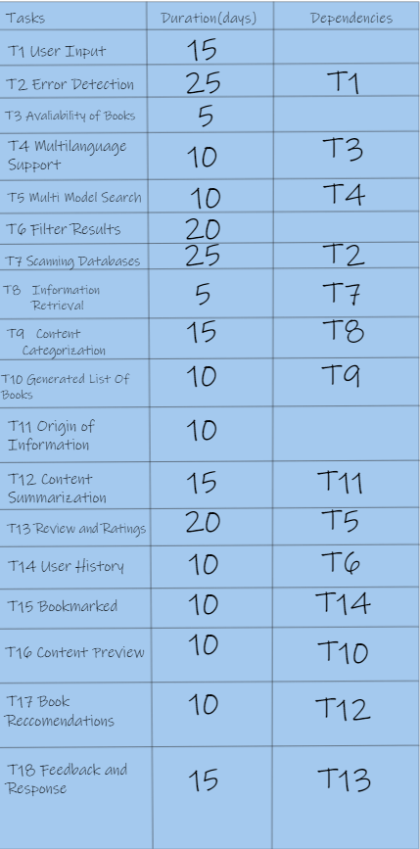
Step 16 – Activity Table

Slide 19
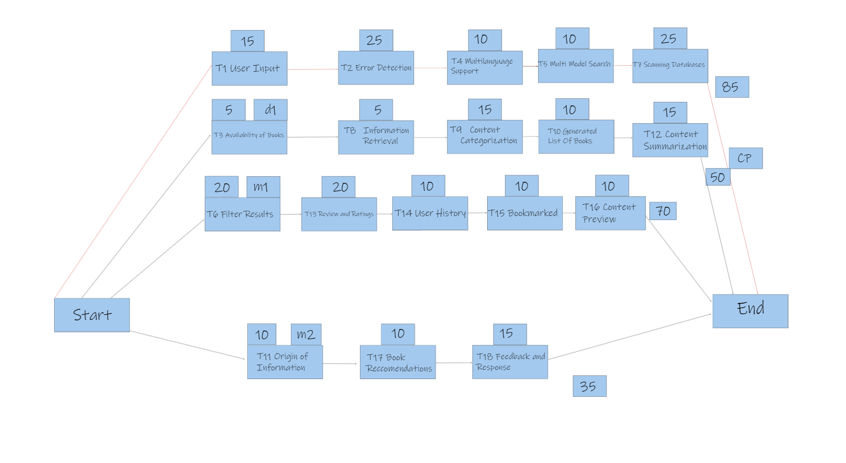
Step 16 – Activity Chart

Slide 20
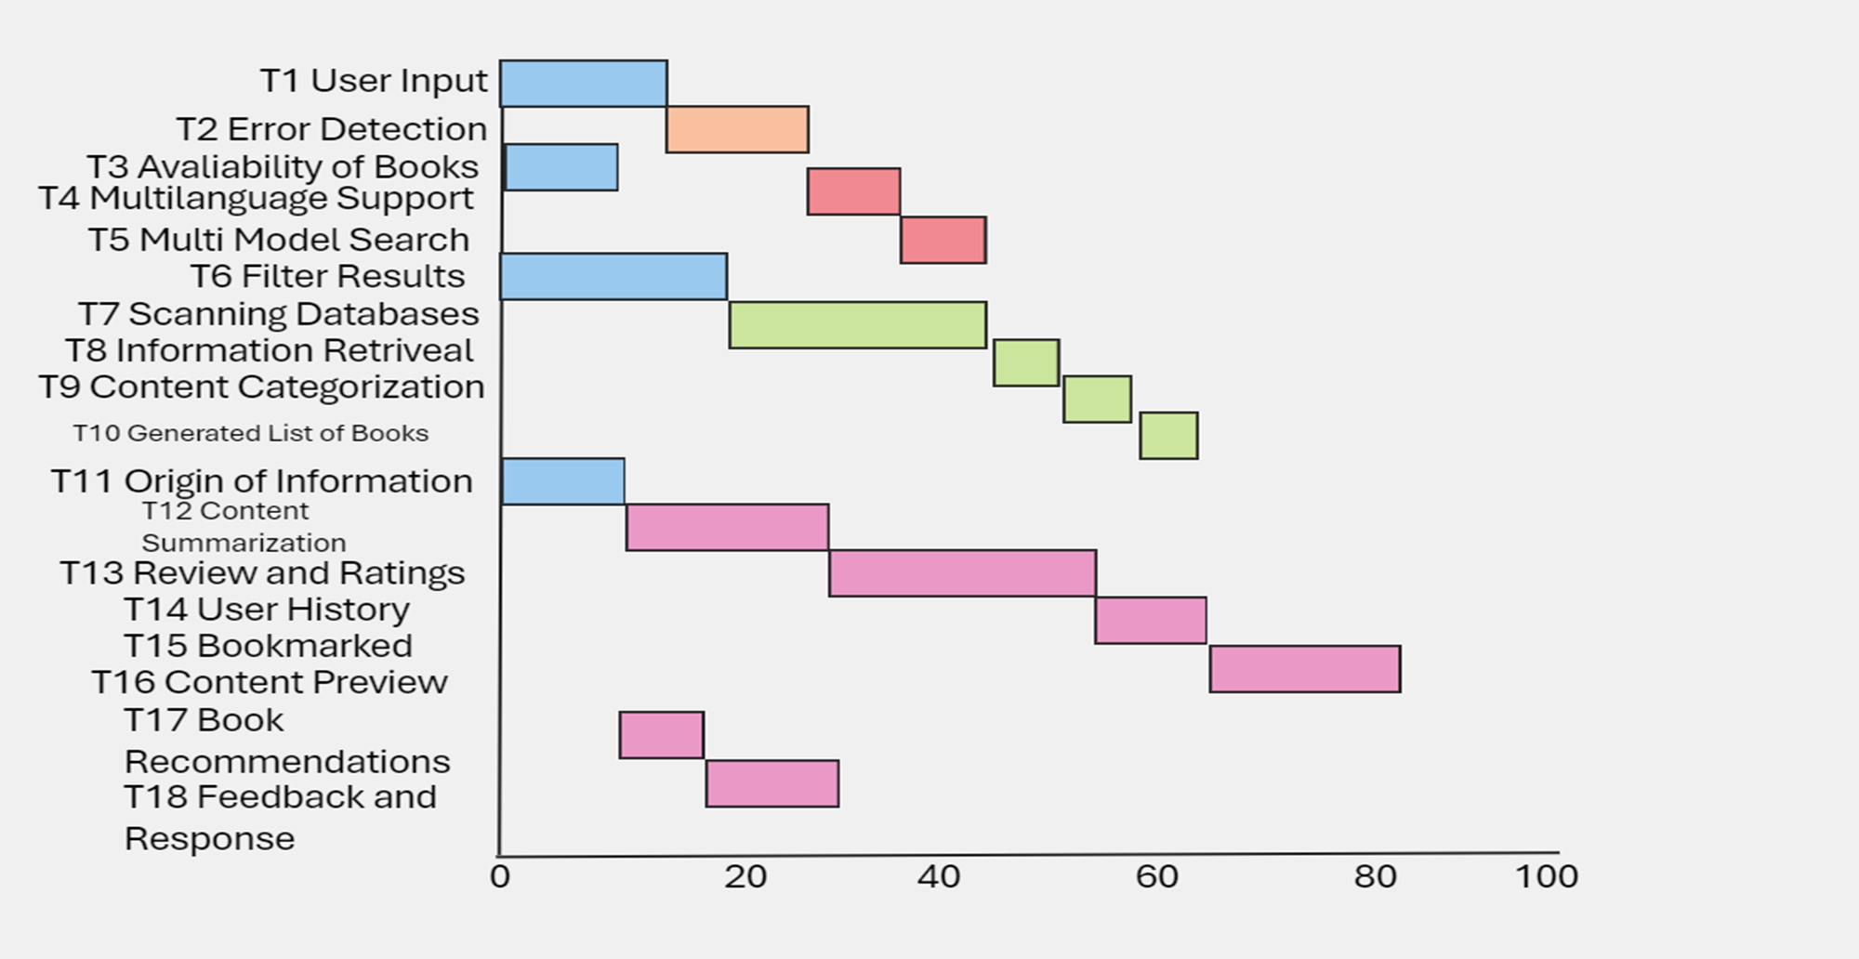
Step 16 – Bar Chart

Slide 21
Step 17 – Verification and Validation
Verification: Meets the specification – Testing and ensuring all required specifications of the software are met
such as filtering service requests by the user or printing a list of generated books sorted by authors. While also
storing each input by the user for future use, scanning different databases and meeting each specified requirements
listed/proposed design leading to fully ensuring our verification tests. Furthermore, we can perform multiple
verification tests at multiple phases of the development process.
Validation: Meets client’s needs at delivery – Having our project meet our client’s needs at delivery can be done by
implementing more testing techniques such as acceptance and integration testing allowing for various functions of the software to be checked in accordance with the client’s needs. In this case checking if the AI Chatbot for Books
can for example scan an assortment of databases, print the listed books that match and then give recommendations
based on what book topic the user has asked for. Allowing for a smooth transition from one function to the last.

Slide 22

Step 18 - P-1 Test Plan (using STUB*)

Slide 23
Step 19 – Post-Delivery Maintenance
Inhouse Maintenance – In-house software development is the process of assembling and retaining a committed group of software engineers within your company to produce and support solutions, tools, and applications. This strategy entails directly employing and supervising technical experts who exclusively work for your organization, coordinating their efforts with corporate goals and objectives. Organizations manage the whole software development lifecycle internally rather than hiring outside firms or contracts.
Outsource Maintenance – The process of performing either some or all of the scheduled and unforeseen industrial maintenance requirements of a plant with external, contractual staff. The benefits of outsourced maintenance serve as an example of why a facility or organization could choose this course of action. These benefits include increased dependability, financial advantages, and integrated and streamlined operations.
Decision – The experience and intuition of software practitioners play a major role in the decision-making process in software development and maintenance. For instance, engineers prioritize issue patches based on their experience, managers allot development and testing resources based on their gut instinct, and so on.
Corrective maintenance example – Corrective maintenance examples include failing to Repair that returns a malfunctioning asset to operational status. When an asset is overhauled, it is returned to the fully operational state specified by maintenance serviceability standards. The last step is salvage, which involves getting rid of materials that are beyond repair and using salvaged components from irreparable assets.
Perfective Maintenance example – A few examples of perfective maintenance are reorganizing data sets within a database to make them easier to search or use less storage, providing shortcut commands that experts can use instead of the slower standard menu system, enhancing code functionality, optimizing speed, changing or adding another way users can log in and removing features that are not effective and functional.
Adaptive Maintenance example - Examples of adaptive maintenance include optimizing code and resources, restructuring code logic, clarifying and improving system documentation, minor functionality enhancements, updating services, making modifications to vendors, changing payment processors
and modifying the product to run on new platforms or operating systems.

Slide 24
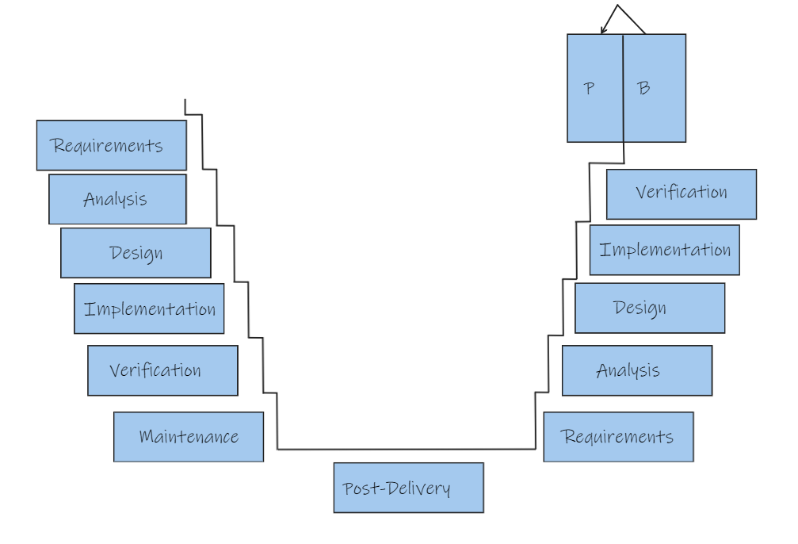
Step 20 - Decommission, seamless transition, training, preparation
Items to be considered
- Developing a new software system
- Planning a seamless transition to the new SW System
- Testing
- Training
- Preparation Plan
- Load the system on a back up main frame
- Transfer to primary on a quiet Sunday
- Fix any problem/error
- Try for a seamless transfer again

Slide 25
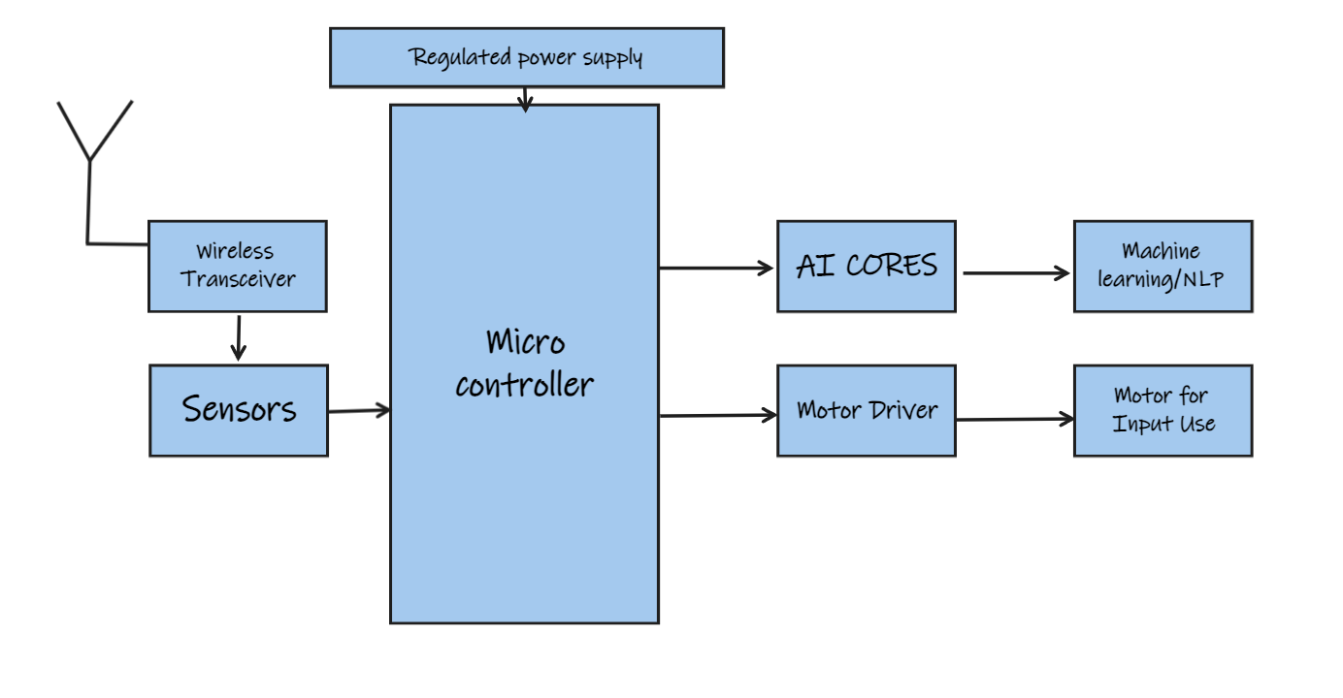
Step 21- Remote Robot
This Robot is designed to categorize an assortment of books using an AI chatbot.
Main Objectives – Categorize books, detail origin of information, detect any errors, search through texts/images and recommending other books while generating content previews and saving the user’s input history.
The project’s learning outcomes – Improved machine learning performance, streamlining administrative tasks, provide personalized
learning/results and programming the robot to generate a list of sorted books based off any user input.
Hardware – Microcontrollers, Motors, Sensors, actuators, effectors and connectors.
Software Used - TensorFlow for machine learning helping train neural networks, improve information retrieval capabilities and it has
more deep learning abilities. Proteus for hardware simulation enabling rapid prototyping of hardware. MPLAB an IDE for
Embedded applications on PIC and ds-PIC microcontrollers.

Slide 26
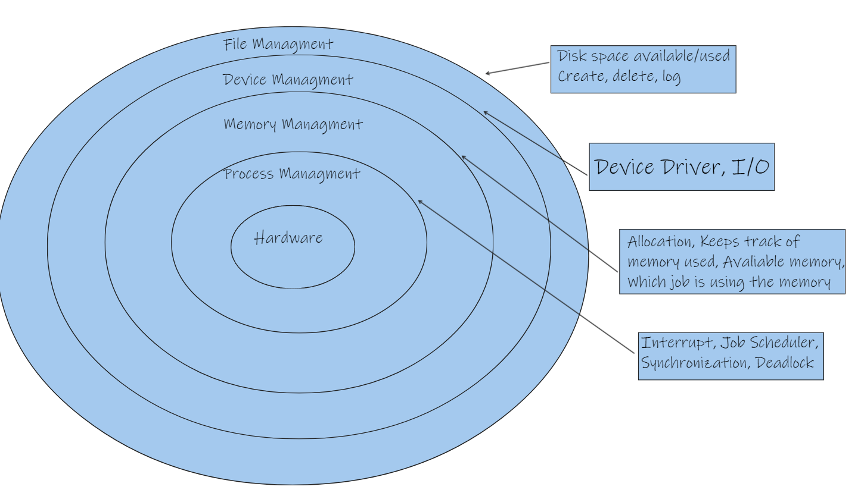
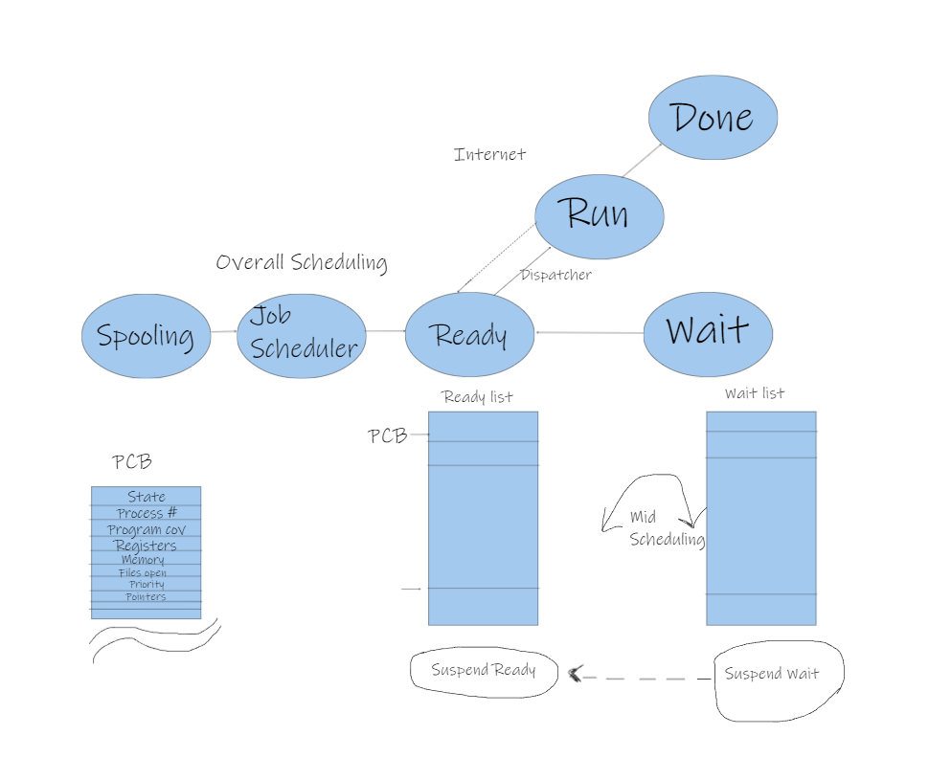
Step 22 -
Hierarchical View –
Process View -
Data Sets – The WikiQA Corpus is a chatbot dataset that allows academic research featuring Wikipedia articles. An
open domain that helps improve answering accuracy using natural language processing.
Database – Relational databases store data in tables and can help our chatbot handle structured data and support
queries that handle user input and store history.
Data Science – Books generated by AI chatbots can utilize natural language processing tasks such as text
classification, sentiment analysis and language translation.
Algorithms – Using decision trees to classify certain text models that are searched for during the beginning stages
of the Book AI generated response.
Statistics – Through the use of Bayesian statistics my chatbot can analyze data and estimate parameters.
Operating System – The best Operating system for my Book generated by AI chatbot is Linux because it is the
most ideal platform for building chatbots, it has many contributing developers that contribute to open source chatbot frameworks such as RASA.

Slide 27
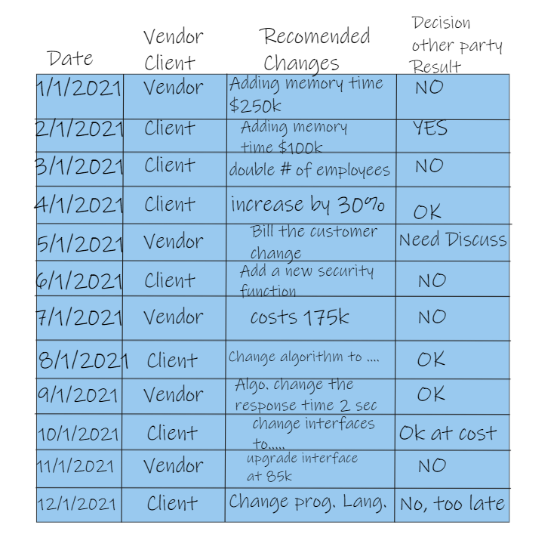
Step 23 – Activity Log

Slide 28
Step 24 – Code Modifications
Class Search Queries
Line 15 of class SearchQueries check if you can search through a database queries. Make sure that if the database is not found in our available database it returns a false or if it does find the information in the database it returns found.
public boolean searchDatabase(String query) {
try {
Connection connection = DriverManager.getConnection(jdbcUrl, username, password);
String sql = "SELECT * FROM your_table WHERE column_name = ?"; PreparedStatement statement = connection.prepareStatement(sql);
statement.setString(1, query);
ResultSet resultSet = statement.executeQuery();
boolean found = resultSet.next(); resultSet.close();
statement.close();
connection.close();
return found;
}
catch (SQLException e) {
e.printStackTrace();
return false;
Class Service Requests
Line 220 of class ServiceRequests add a new functions that allow a user’s history to be saved and accessed. Using the ArrayList to store the user’s history and the two methods to to add and return the userHistory.
public ServiceRequests() { userHistory = new ArrayList<>();
}
public void addRequest(String request) { userHistory.add(request);
}
public List<String> getUserHistory() { return userHistory;
}

Slide 29
Thank You

